Slide 1

7th Grade Math
Unit 11, Lesson 5 Is It Proportional? Volume 2, pg. 169

Slide 2


Benchmarks
MA.7.AR.4.1
Determine whether two quantities have a proportional relationship by examining a table, graph, or written description.
MA.7.AR.4.2
Determine the constant of proportionality within a mathematical or real-world context given a table, graph, or written description of a proportional relationship.
volume 2, pg. 169

Slide 3
Integrated Mathematical Thinking and Reasoning Standards
MA.K12.MTR.1.1 Actively participate in effortful learning both individually and collectively.
MA.K12.MTR.2.1 Demonstrate understanding by representing problems in multiple ways.
MA.K12.MTR.5.1 Use patterns and structure to help understand and connect mathematical concepts.
MA.K12.MTR.7.1 Apply mathematics to real-world contexts.
volume 2, pg. 169

Slide 4

Learning Targets
I can determine if two quantities have a proportional relationship.
I can determine the constant of proportionality of a proportional relationship.
volume 2, pg. 169

Slide 5

Warm-Up
volume 2, pg. 169

Slide 6
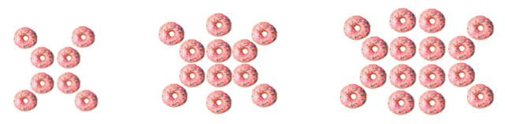
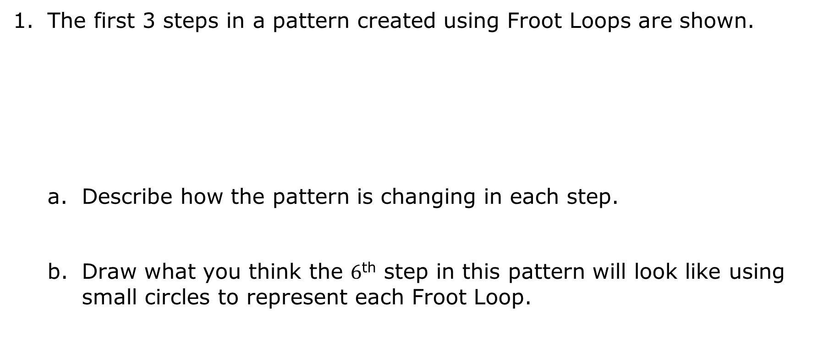
11.5.1 Warm-Up: Visual Pattern
The first 3 steps in a pattern created using Froot Loops are shown.
Describe how the pattern is changing in each step.
Draw what you think the $6$^{th} step in this pattern will look like using small circles to represent each Froot Loop.
volume 2, pg. 169

Slide 7

Guided Practice
volume 2, pg. 170

Slide 8

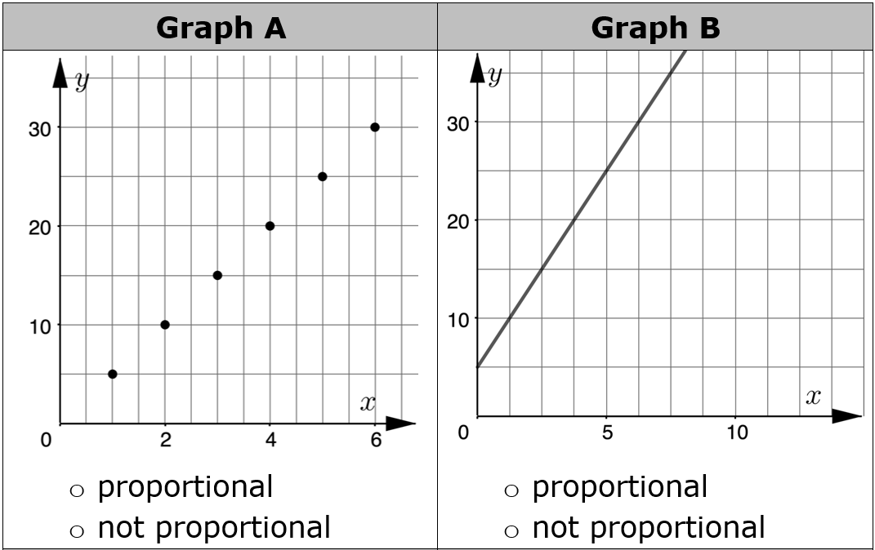
11.5.2 Guided Practice: Determine If a Relationship Is Proportional from Tables and Graphs
Four graphs are shown in the chart. Indicate whether each graph represents a proportional relationship.
volume 2, pg. 170

Slide 9
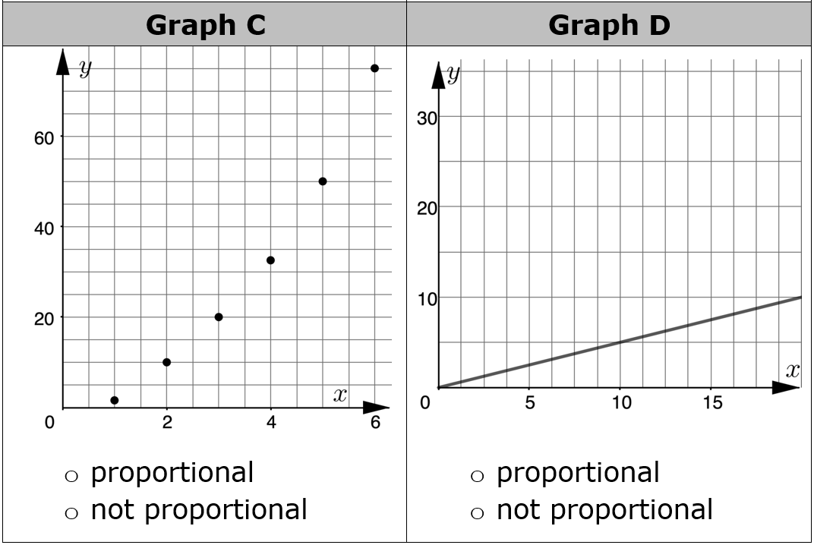
volume 2, pg. 170

Slide 10
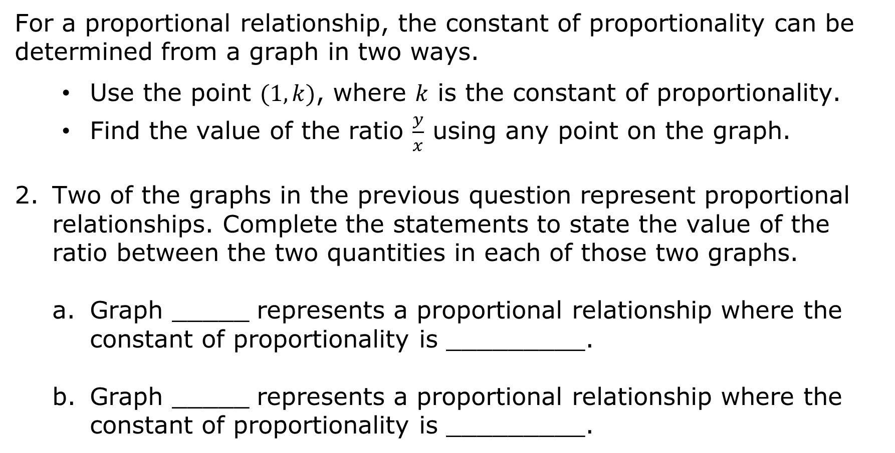
For a proportional relationship, the constant of proportionality can be determined from a graph in two ways.
Use the point $(1, k)$, where $k$ is the constant of proportionality.
Find the value of the ratio $\frac{y}{x}$ using any point on the graph.
Two of the graphs in the previous question represent proportional relationships. Complete the statements to state the value of the ratio between the two quantities in each of those two graphs.
Graph _____ represents a proportional relationship where the constant of proportionality is _________.
Graph _____ represents a proportional relationship where the constant of proportionality is _________.
volume 2, pg. 170

Slide 11
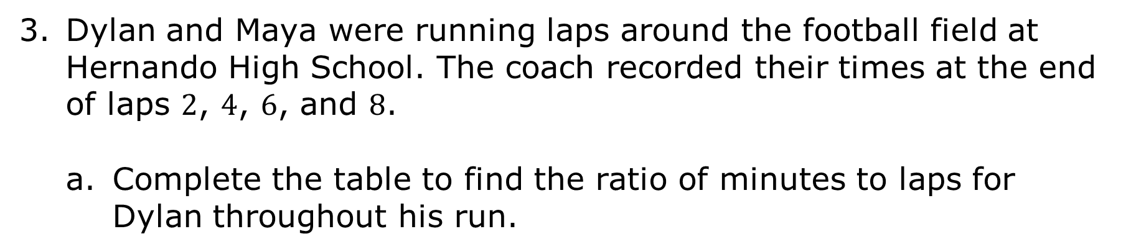
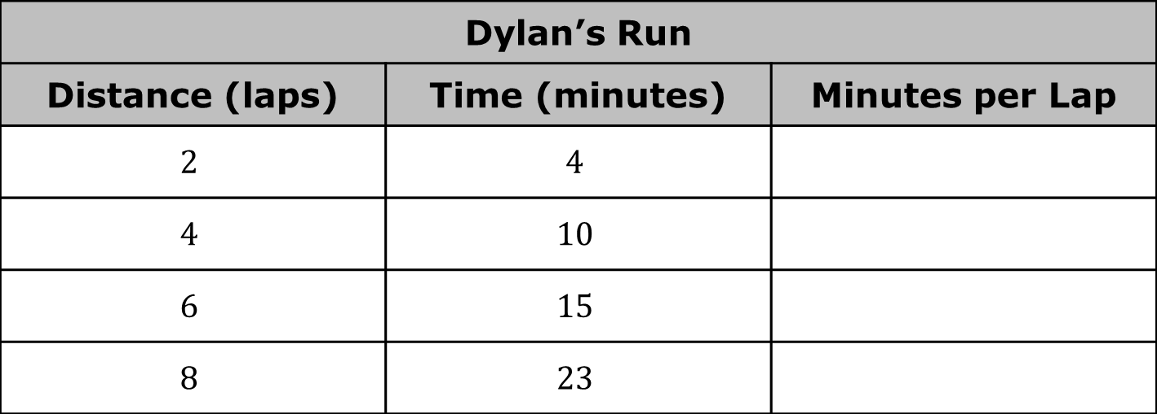
Dylan and Maya were running laps around the football field at Hernando High School. The coach recorded their times at the end of laps $2$, $4$, $6$, and $8$.
Complete the table to find the ratio of minutes to laps for Dylan throughout his run.
Dylan’s Run
Distance (laps) | Time (minutes) | Minutes per Lap
$$2$$ | $$4$$
$$4$$ | $$10$$
$$6$$ | $$15$$
$$8$$ | $$23$$
volume 2, pg. 171

Slide 12
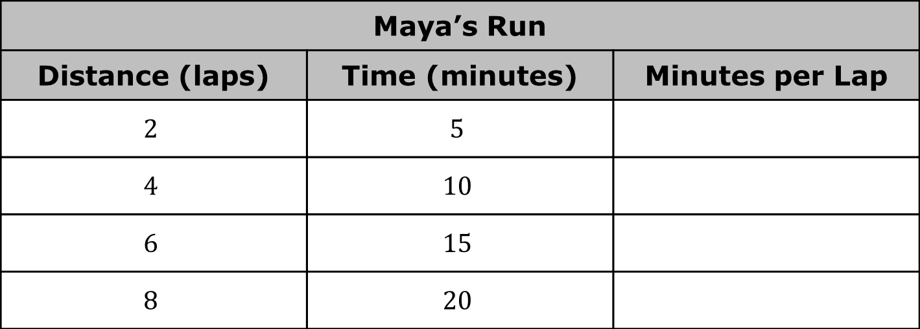
Complete the table to find the ratio of minutes to laps for Maya throughout her run.
Maya’s Run
Distance (laps) | Time (minutes) | Minutes per Lap
$$2$$ | $$5$$
$$4$$ | $$10$$
$$6$$ | $$15$$
$$8$$ | $$20$$
volume 2, pg. 171

Slide 13
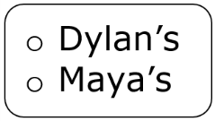

Complete the statement.
The table of values representing run is a proportional relationship. The constant of proportionality is _________.
When determining whether two quantities have a proportional relationship from a table, check every pair of values in the table to determine if the ratios between them are all equivalent.
volume 2, pg. 171

Slide 14

Guided Instruction
volume 2, pg. 172

Slide 15
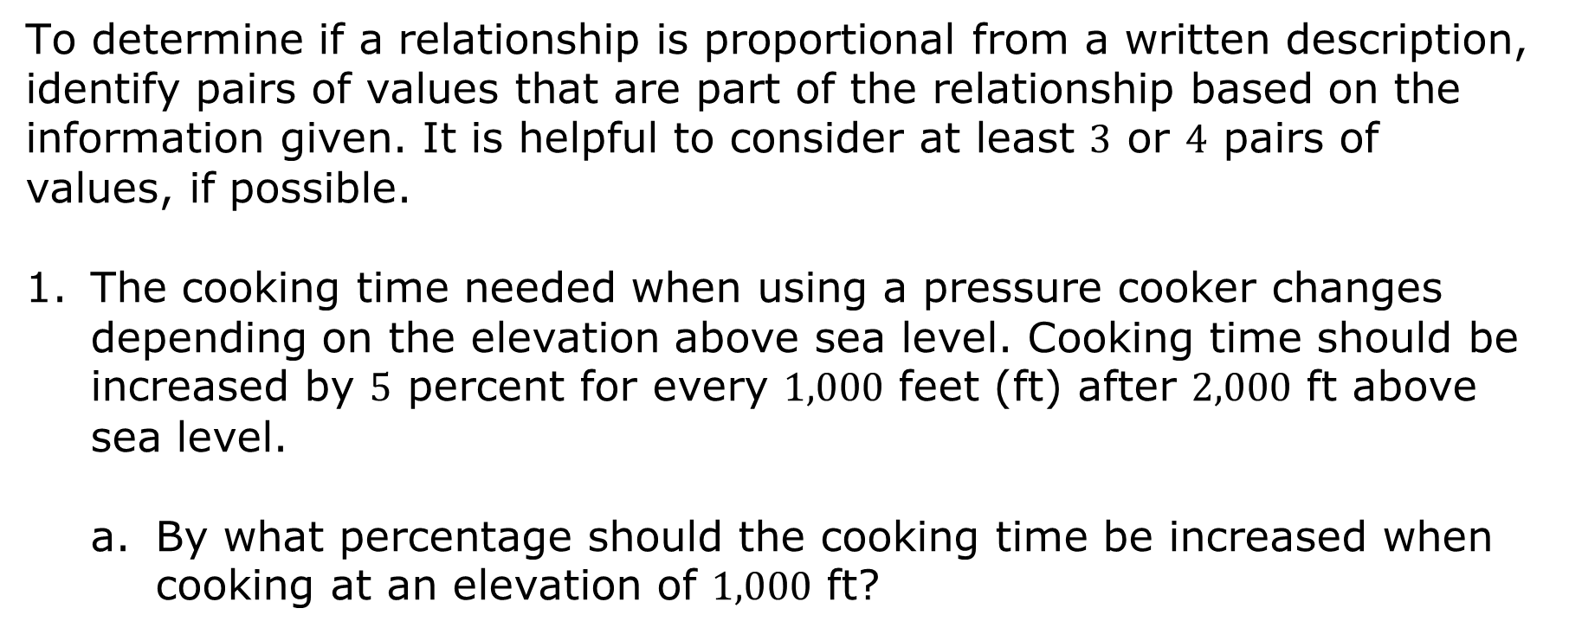
11.5.3 Guided Instruction: Determining If a Relationship Is Proportional from a Written Description
To determine if a relationship is proportional from a written description, identify pairs of values that are part of the relationship based on the information given. It is helpful to consider at least $3$ or $4$ pairs of values, if possible.
The cooking time needed when using a pressure cooker changes depending on the elevation above sea level. Cooking time should be increased by $5$ percent for every $1,000$ feet (ft) after $2,000$ ft above sea level.
By what percentage should the cooking time be increased when cooking at an elevation of $1,000$ ft?
volume 2, pg. 172

Slide 16
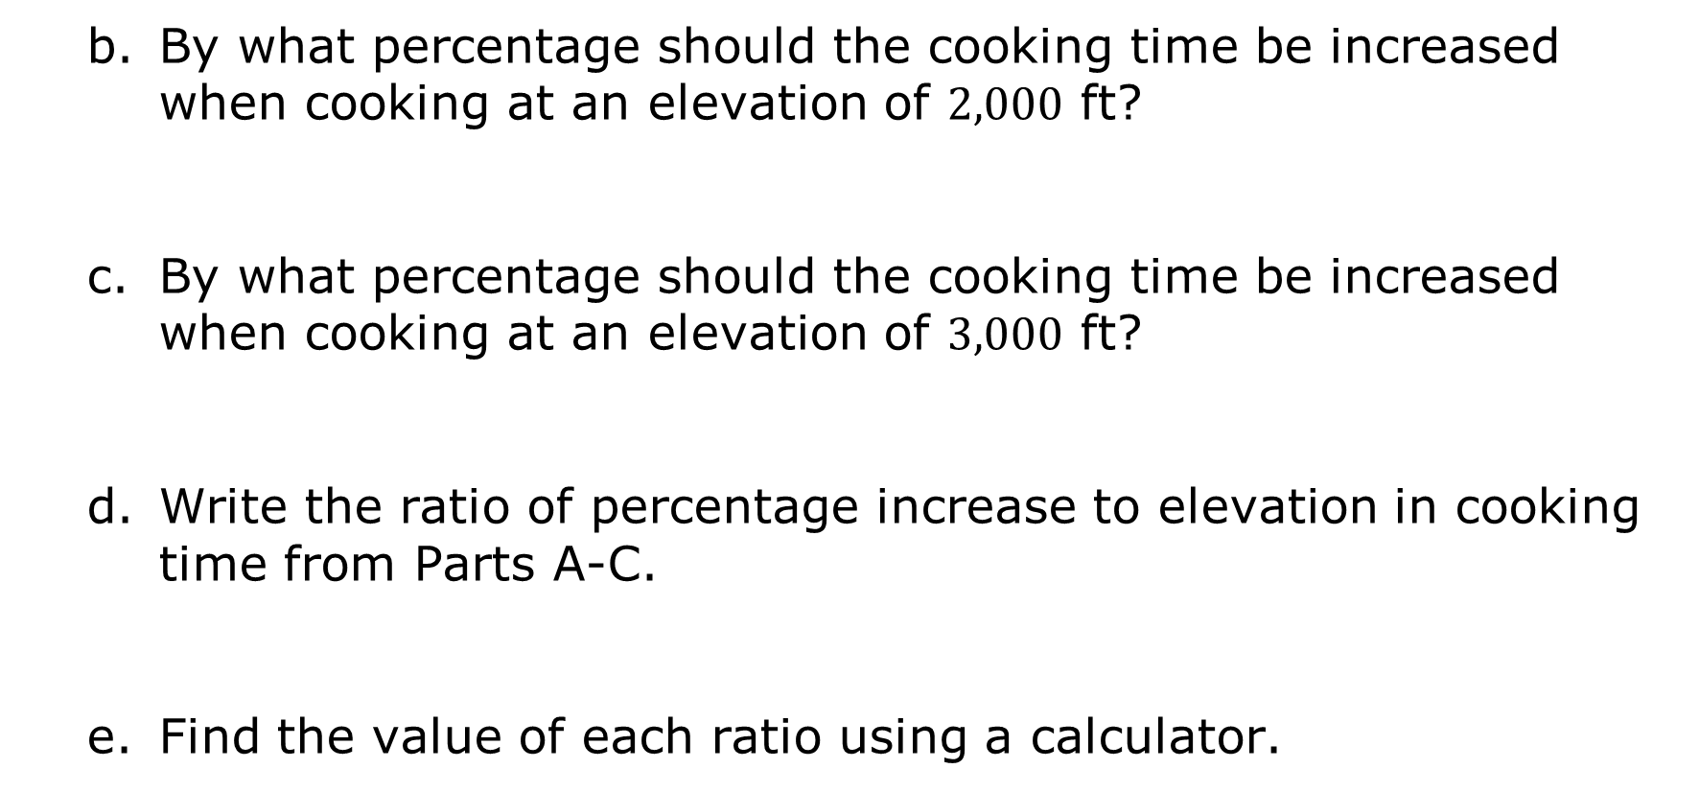
By what percentage should the cooking time be increased when cooking at an elevation of $2,000$ ft?
By what percentage should the cooking time be increased when cooking at an elevation of $3,000$ ft?
Write the ratio of percentage increase to elevation in cooking time from Parts A-C.
Find the value of each ratio using a calculator.
volume 2, pg. 172

Slide 17
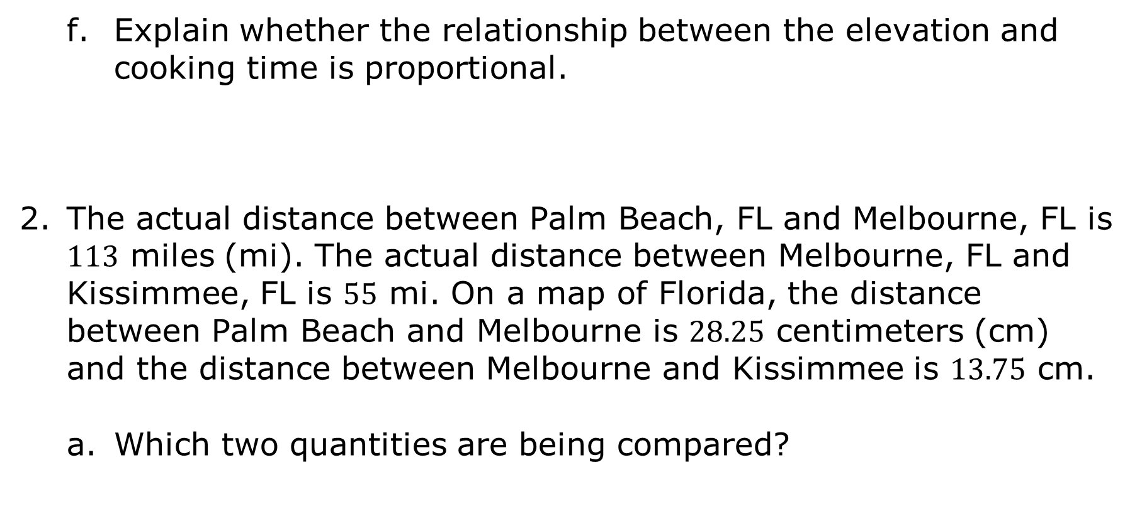
Explain whether the relationship between the elevation and cooking time is proportional.
The actual distance between Palm Beach, FL and Melbourne, FL is $113$ miles (mi). The actual distance between Melbourne, FL and Kissimmee, FL is $55$ mi. On a map of Florida, the distance between Palm Beach and Melbourne is $28.25$ centimeters (cm) and the distance between Melbourne and Kissimmee is $13.75$ cm.
Which two quantities are being compared?
volume 2, pg. 172

Slide 18
Identify pairs of values of the two quantities being compared.
Determine whether the relationship between the two quantities is proportional. If it is proportional, state the constant of proportionality. If it is not proportional, explain why not.
volume 2, pg. 173

Slide 19

Try It
volume 2, pg. 173

Slide 20

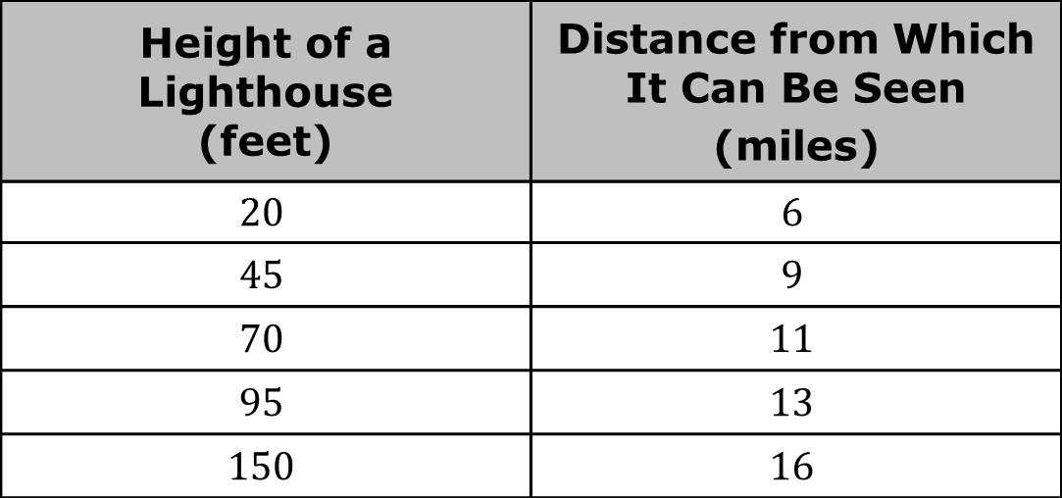
11.5.4 Try It: Determining If a Relationship Is Proportional
The table shows the distance from which a lighthouse is visible to a boat at sea.
Determine whether the table represents a proportional relationship.
Height of a Lighthouse (feet) | Distance from Which It Can Be Seen (miles)
$$20$$ | $$6$$
$$45$$ | $$9$$
$$70$$ | $$11$$
$$95$$ | $$13$$
$$150$$ | $$16$$
volume 2, pg. 173

Slide 21
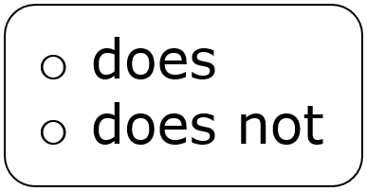

Complete the statements.
The table represent a proportional relationship.
volume 2, pg. 173

Slide 22
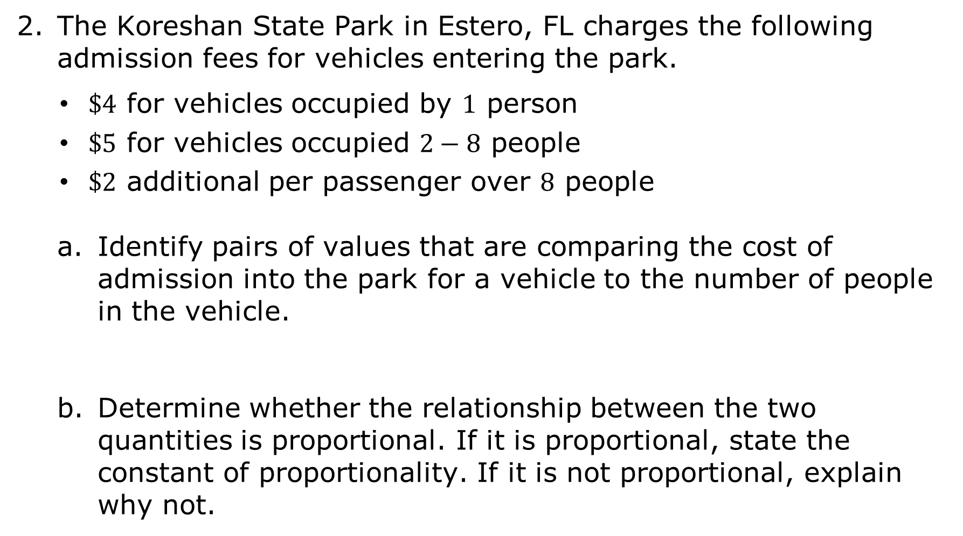
The Koreshan State Park in Estero, FL charges the following admission fees for vehicles entering the park.
$\$4$ for vehicles occupied by $1$ person
$\$5$ for vehicles occupied $2−8$ people
$\$2$ additional per passenger over $8$ people
Identify pairs of values that are comparing the cost of admission into the park for a vehicle to the number of people in the vehicle.
Determine whether the relationship between the two quantities is proportional. If it is proportional, state the constant of proportionality. If it is not proportional, explain why not.
volume 2, pg. 174

Slide 23
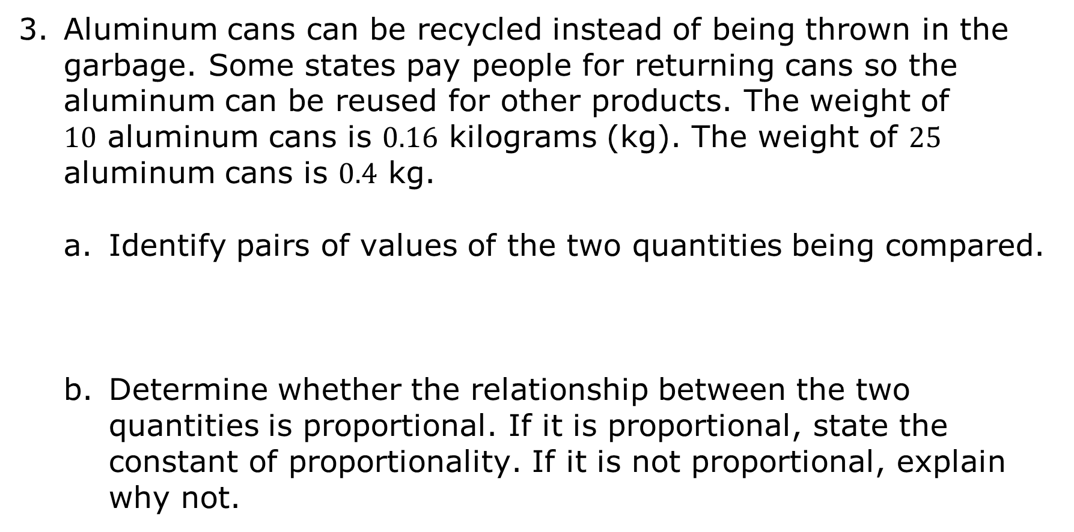
Aluminum cans can be recycled instead of being thrown in the garbage. Some states pay people for returning cans so the aluminum can be reused for other products. The weight of $10$ aluminum cans is $0.16$ kilograms (kg). The weight of $25$ aluminum cans is $0.4$ kg.
Identify pairs of values of the two quantities being compared.
Determine whether the relationship between the two quantities is proportional. If it is proportional, state the constant of proportionality. If it is not proportional, explain why not.
volume 2, pg. 174

Slide 24

Wrap-Up
volume 2, pg. 175

Slide 25
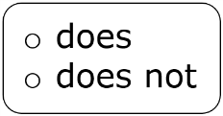
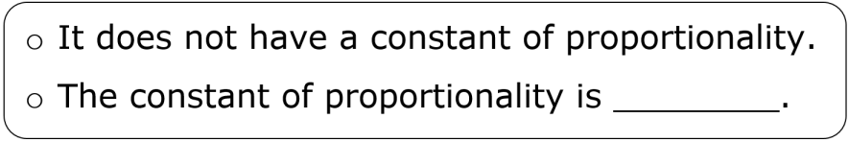
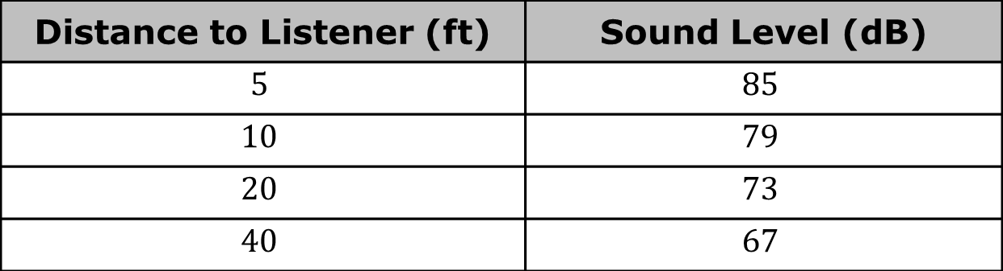
11.5.5 Wrap-Up: Ticket Out the Door
The table shows how loud a sound is, in decibels (dB), depending on how far away the listener is from it, in feet (ft).
Use the table to complete the statements.
The table represent a proportional relationship.
Distance to Listener (ft) | Sound Level (dB)
$$5$$ | $$85$$
$$10$$ | $$79$$
$$20$$ | $$73$$
$$40$$ | $$67$$
volume 2, pg. 175

